Slide 1
Engineering Ethics
[BAE707]
Dr Sam Man Keong
Email: sammk1951@gmail.com
HP: +65 96740515
Date: 23 May 2020

Slide 2
Outlines
About your trainer
Lecture No/Topic
Textbooks
Assessment Types & Methods

Slide 3
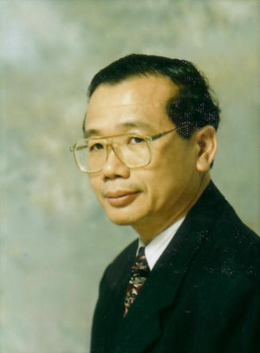
Prof (Dr) Sam Man Keong
Academic:
BE(Civil)(Hons)(MelbU), MSc9Civil)(NUS), MSc(Geot Eng)(NTU), EdD(WMSU), GradDip(App Stat (RMIT), GDSTT(CIAE)
Professional:
CEng, FIET, MICE, MCIOB, FCQI, CQP, FCABE, CBuildE, CEnv, CMath, MIMA, CSci, FSPE, PEng(Int), FSIB, FSIET(F).
Email: sammk1951@gmail.com

Slide 4
Lecture No/Topic
No | Topic | Reference(*)
1 | Human Values | Chapter 1 (*)
2 | Engineering Ethics | Chapter 2 (*)
3 | Engineering as Social Experimentation | Chapter 3 (*)
4 | Safety, Responsibilities and Rights | Chapter 4 (*)
5 | Global Issues | Chapter 5 (*)
*Essential Textbook: Professional Ethics and Human Values by R. S. Naagarazan

Slide 5
Textbooks
1 | Naagarazan, R.S. (2006). Professional Ethics and Human Values. Published by New Age International. [Website: www.newagepublishers.com ]
2 | Harris, C.E., Pritchard, M.S., and Rabins, M.J. (2009). Engineering Ethics: Concepts and Cases. Published by Wadworth Cengage Learning. 4th edition (2009)
3 | Fleddermann, C.R. (2012). Engineering Ethics. Published by Prentice Hall. 4th edition (2012)
1 = Essential Textbook 2, 3 = Additional Reading

Slide 6
Assessment Types & Methods : Option A – 100% Course works
5 Reports [20 Marks per Report]
1 | Human Values
2 | Engineering Ethics
3 | Engineering as Social Experimentation
4 | Safety, Responsibilities and Rights
5 | Global Issues
Suggested Format for Report (6-8 pages)
1 | Introduction: History; Definitions [1 page][2 Marks]
2 | Background: Problems/Issues* [2 – 4 pages][8 Marks]
3 | Discussion: Review/Code of Ethics/Findings* [1 page][4 Marks]
4 | Conclusion [1 page][4 Marks]
5 | *List of References [1 page][2 Marks]

Slide 7
Assessment Types & Methods : Option B – online Exam
Duration :3 hours
Section A | 20 MCQs (2 Marks each)
Section B | 2 Case Studies (30 marks each)
Total Marks: 100 Suggested Pass Mark : Above 80

