Slide 1
RUNWAYS
Runway Orientation

Slide 2
Runway Orientation
Runways are always oriented in the direction of prevailing wind
Aircraft not maneuver safely at the wind contains a large component at right angle to the direction of travel
Right angle component of wind➔
“Cross wind”

Slide 3
Wind Direction
V cos θ
v
v
θ
θ
V sin θ
Cross Wind Component
Runway Center Line

Slide 4
Wind Rose Diagram
velocity, direction, duration are represented by a diagram ➔ “Wind Rose”
Use graphical procedure
to analyze the wind data for the determination of the best runway orientation
Wind rose diagram wind covers angle 22.5 degree
Assume➔ wind come from any pt. within 22.5 degree
Data➔ 5 to 10 years

Slide 5
Two Methods
Method I
Method II

Slide 6
Method I
Absence of wind velocity, not account for cross wind component
Not so accurate
Radial Line➔ Wind Direction
Frequency of wind is marked on radial line (Scale)
Plotted pt. are joined by straight line
The best runway➔ longest line on wind rose diagram

Slide 7
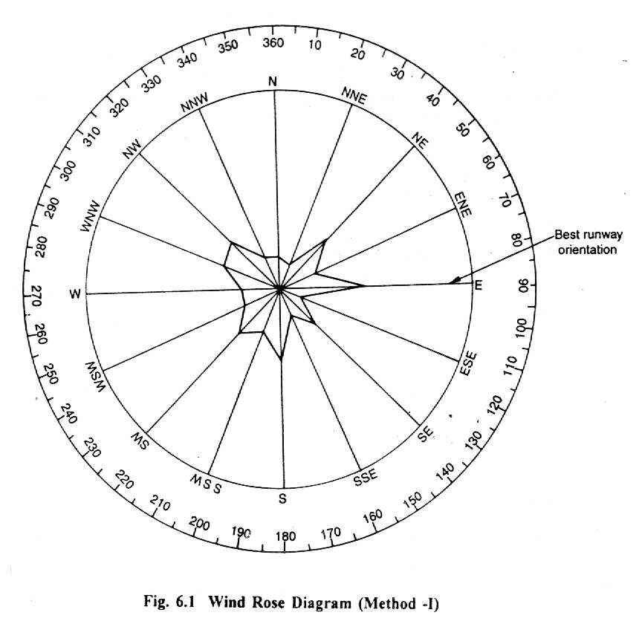

Slide 8
Method II
Wind data
Direction, Duration, Intensity
Circle ➔ Wind velocity
Radial Line ➔ Wind Direction
% of frequency ➔ appropriate segment
V < 6.4kmph (4mph) ➔ “Calm Period”
Separate Circle ➔ Calm Period

Slide 9
Typical Wind Data
% of Wind s
Direction 6.4-15 15-30 30-47 Total
N 3.6 - - 3.6
NNE 2.7 0.1 - 2.8
NE 6.5 1.0 0.3 7.8
ENE 4.3 0.7 - 5.0
E 6.9 3.0 0.4 10.3
ESE 2.1 0.1 - 2.2
SE 5.4 0.2 - 5.6
SSE 2.6 0.3 - 2.9
S 8.0 0.2 - 8.2
SSW 5.3 0.4 - 5.7
SW 6.1 1.0 0.2 7.3
WSW 4.4 0.5 - 4.9
W 3.8 0.7 0.4 4.9
WNW 6.7 0.9 - 7.6
NW 7.4 0.3 - 7.7
NNW 3.9 0.2 - 4.1
Calms Period 0-6.4 9.4%
Total 100

Slide 10
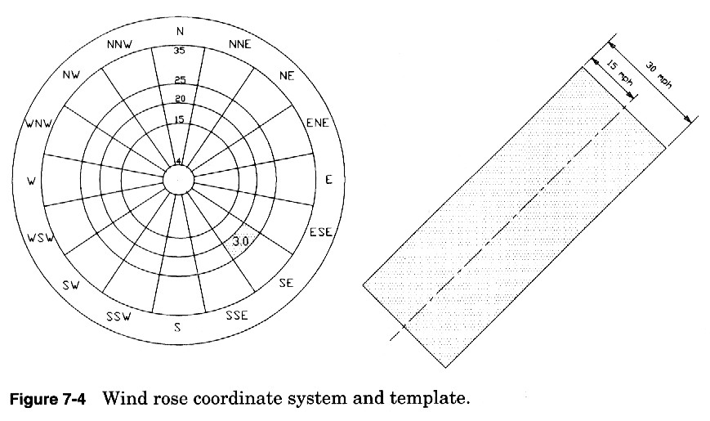

Slide 11
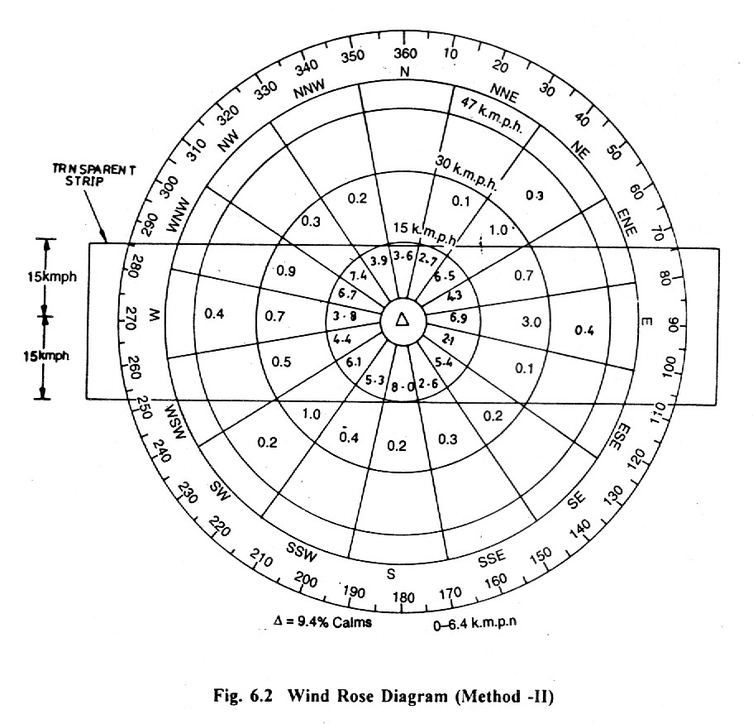

Slide 12
The best runway ➔ EW
Available wind coverage = 97% > 95%
O.K

Slide 13
Another - EX. 1. (see page 145)
Wind coverage = 95%
(i) cross wind component = 15kmph ➔
The best runway orientation = ?
If insufficient wind coverage ➔
Direction of optimal crosswind runway = ?
(ii) Crosswind runway orientation = 30◦ to 210◦ ==> total wind coverage = ?
(i.e primary runway & crosswind runway)

Slide 14
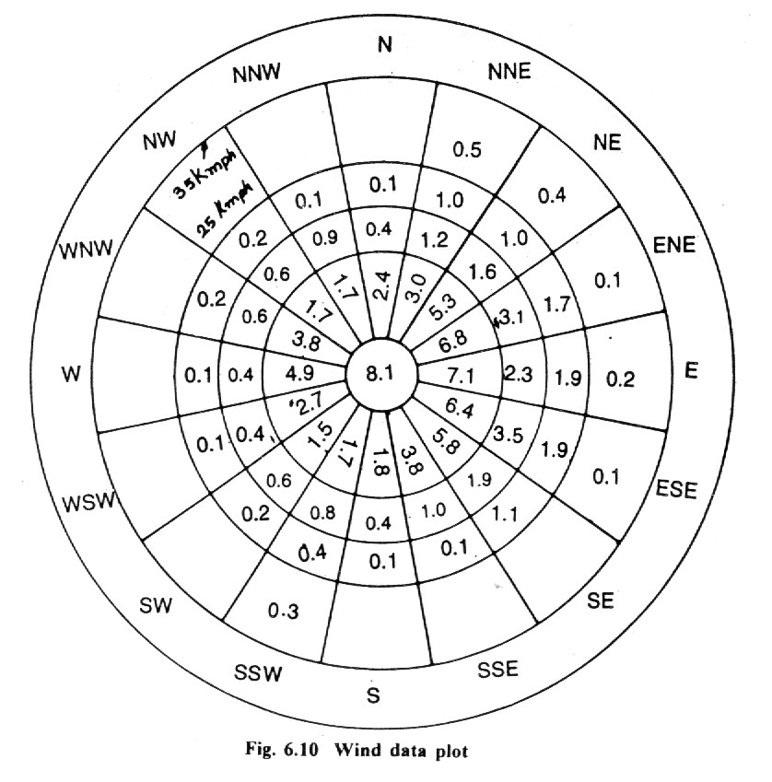

Slide 15
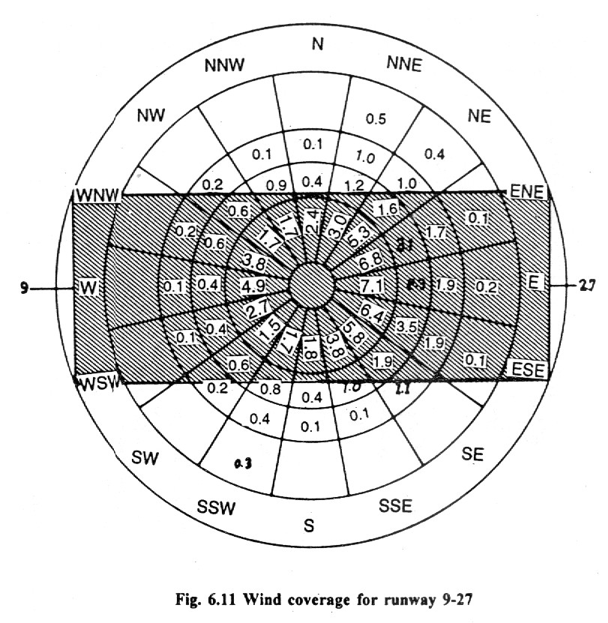

Slide 16
The best runway orientation = 90◦ to 270◦
Runway designation = 9-27
Wind coverage = 90.8 % < 95%
Therefore,
To determine ➔ Secondary runway (crosswind runway)
Orientation = 12◦ to 192◦
Additional wind coverage = 6.2%
Total wind coverage for both primary & crosswind runway = 90.8+6.2 = 97%

Slide 17
(ii)
Crosswind runway orientation = 30◦ to 210◦
Runway designation = 3-21
Wind coverage = 84.8 %
Additional wind coverage = 5.8%
Primary Runway orientation =90◦ to 270◦
Wind coverage for primary =90.8%
Total wind coverage for both = 90.8+5.8 = 96.6%>95% (Fig. 6.13)

Slide 18
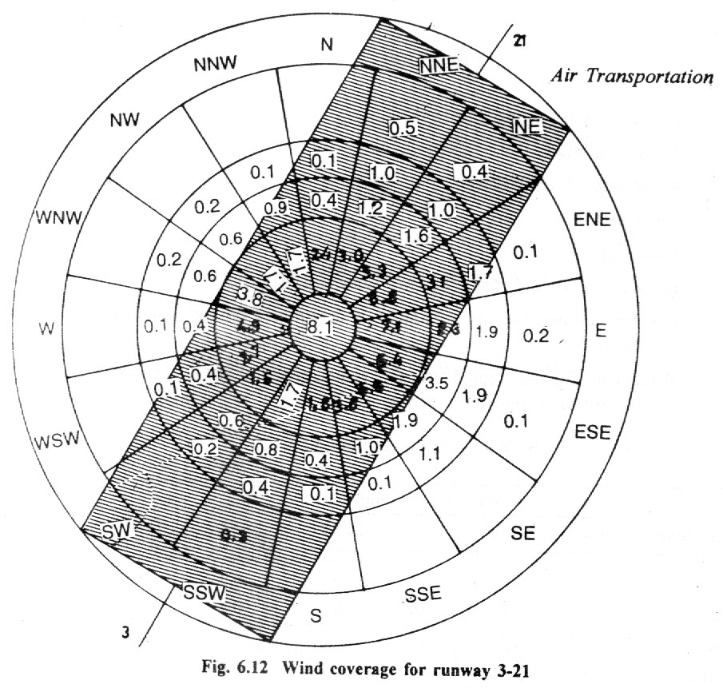

Slide 19
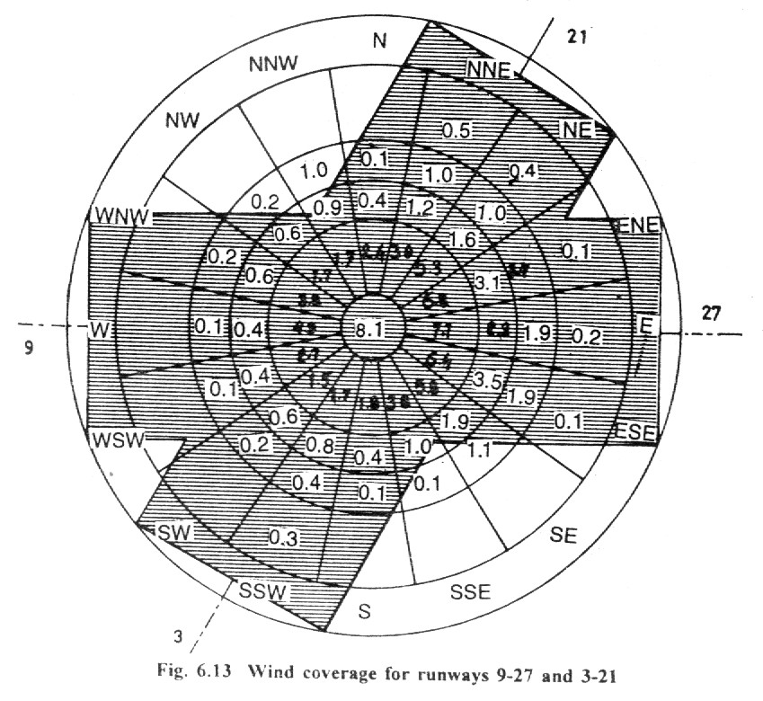

Slide 20
THE END

