Slide 1
Soil ?
Soil Mechanics ?
Geotechnical Engineering ?
Subsoil Exploration
Testings ( In-situ Tests & Laboratory Tests)
SPT, CPT, Vane Shear Test & ------
Moisture content
Index Properties Tests (LL, PL, SL)
Grain Size Distribution Test ( Sieve Analysis & Hydrometer)
Specific Gravity
Shear Strength Tests ( Tri-axial Compr:, Direct Shear, Unconfined Compr:)
Compaction test, CBR Test
Consolidation Test, Permeability Test ----

Slide 2
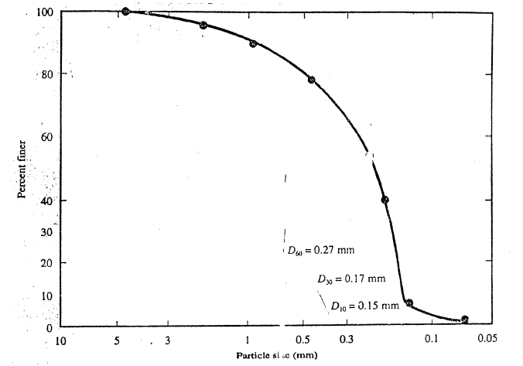
Soil Particle Size ( C.G.S. & F.G.S.)
Partical Size Distribution Curve
D₁₀, C_{u}, C_{c}

Slide 3
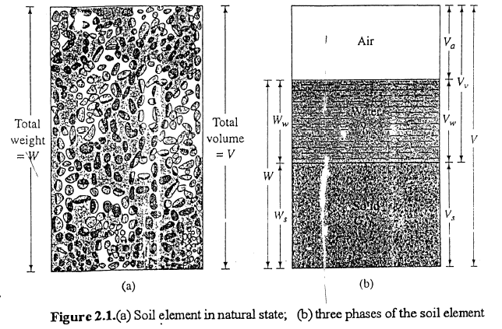
Consistency of Soil
Soil Composition ( Weight-Volume Relationship)

Slide 4
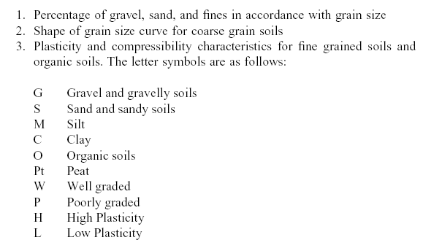
Physical properties of soils ( w, e, n, S_{r}, γ, ρ, ρ_{d}, G_{s}), (PI, LI, D_{r})
Classification of Soils (AASHTO, Unified Classification System)

Slide 5
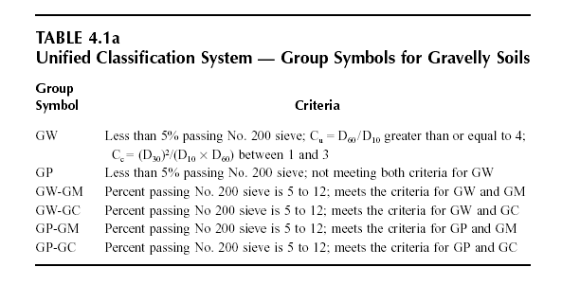

Slide 6
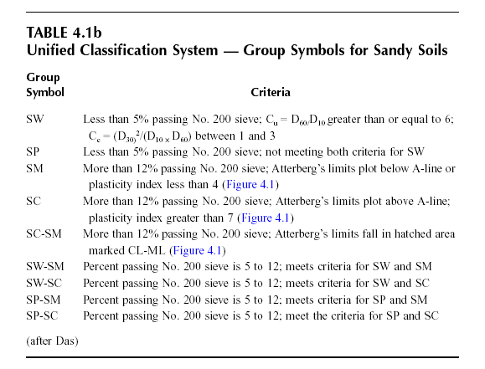

Slide 7
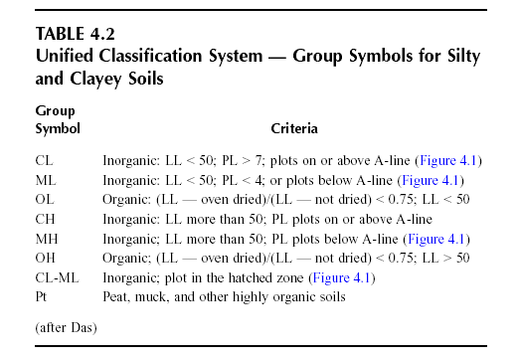

Slide 8
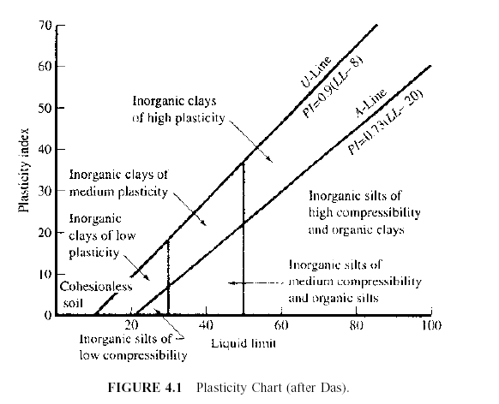

Slide 10
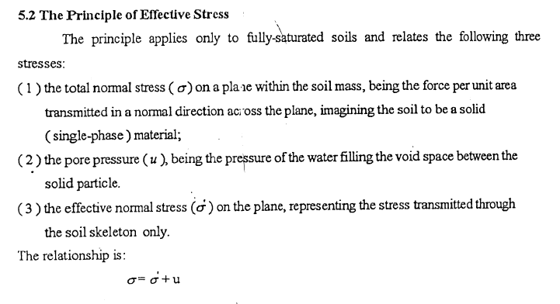

Slide 11
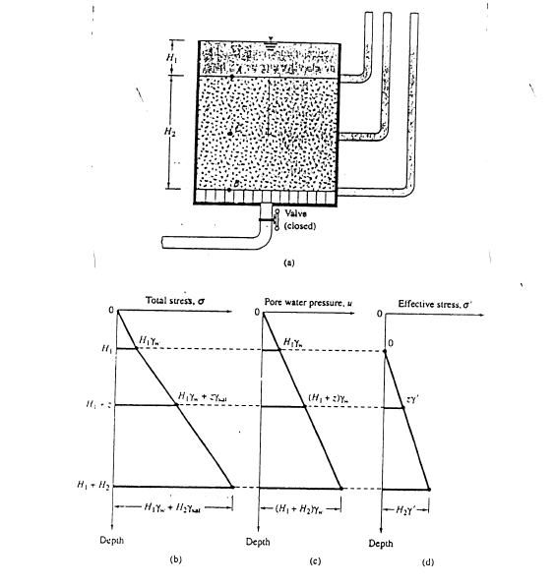

Slide 12
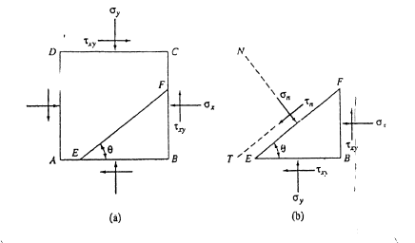
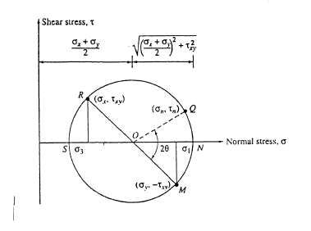
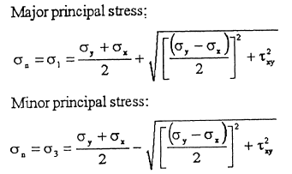
STRESSES IN A SOIL MASS

Slide 13
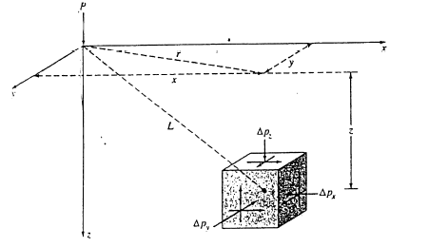
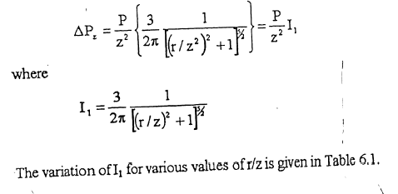
Stress caused by a Point Load

Slide 14
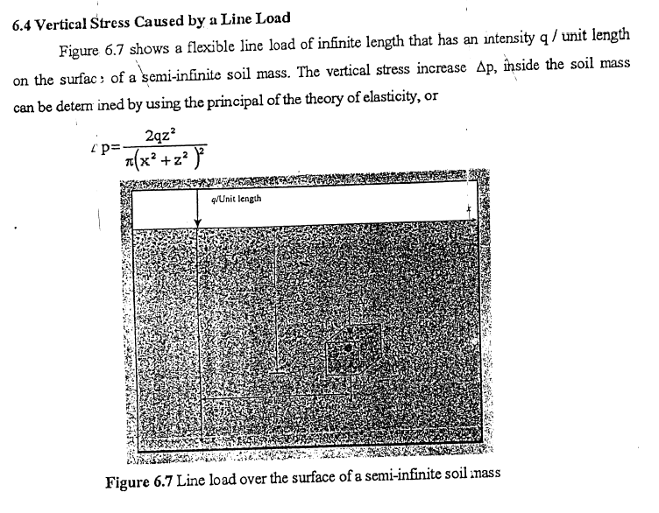

Slide 15
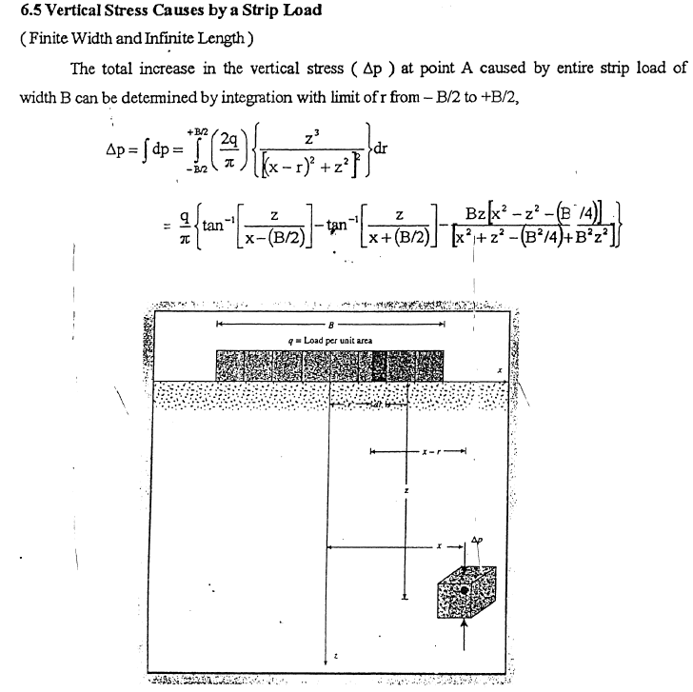

Slide 16
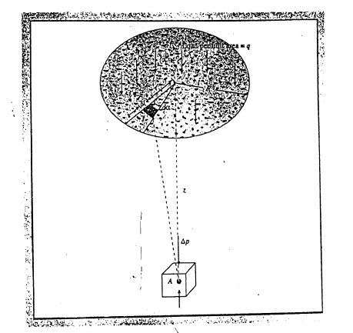

Slide 17
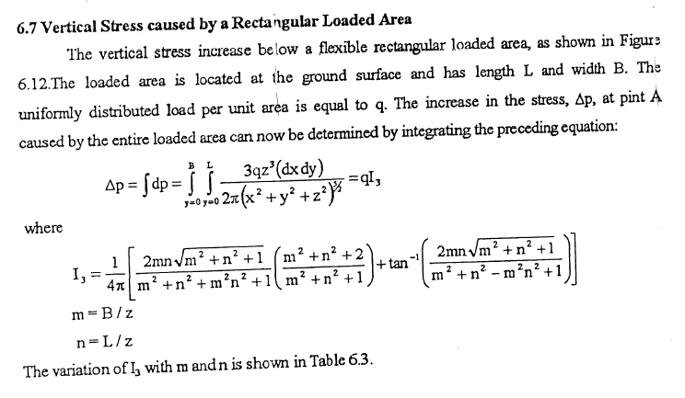

Slide 18
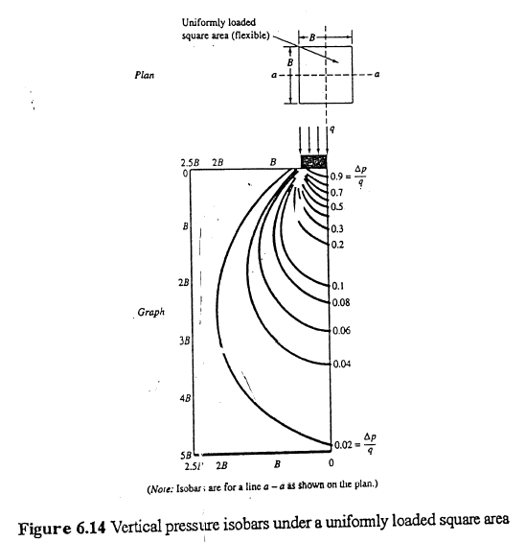
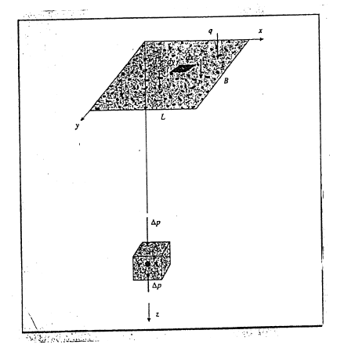

Slide 19
THANK YOU VERY MUCH FOR YOUR ATTENTION !

