Slide 1
MINISTRY OF SCIENCE AND TECHNOLOGY A.G.T.I (Second Year) EP 2012 ELECTRICAL MACHINES AND CONTROL
Presented By
Dr. Aung Ze Ya
Associate Professor
Department of Electrical Power Engineering
Yangon Technological University

Slide 2
EP 2012 ELECTRICAL MACHINES
AND CONTROL Semester II
Part One
PLC
Part Two
Sequence Control
Chapter 1 PLC Basics
Chapter 2 PLC Programming
Chapter 3 PLC Application
Chapter 4 PLC Practice
Chapter 1 Control System Basic
Chapter 2 Sequence Control
Chapter 3 Industrial Machine Controls

Slide 3
PART ONE PLC CHAPTER 1 PLC Basics
 PLC Structure
 PLC in Comparison with Other Control Systems
 PLC’s CPU
PLC’s Memory

Slide 4
 PLC Structure
Programming Terminal
Power
Supply
CPU
Memory
PLC
Input
Module
Output
Module
PROCESS
Input
Devices
Output
Devices

Slide 5
 PLC Structure
Divided into 4 parts, I/O Modules, CPU, Memory and Programming Terminal
Operates by examining the input signals from a process and carrying out logic instructions
Producing output signals to drive process equipment
Standard interfaces built-in to PLC => directly connected to process actuators & transducers without the need for intermediate circuitry or relays

Slide 6
 PLC Structure
Require short installation & commissioning times
Specific features for industrial control:
Noise immune equipment
Modular plug-in construction
Standard I/O connections & signal levels
Easily understood programming language
Ease of programming & reprogramming in-plant
Capable of communicating & reprogramming in-plant
Capable of communicating with other PLCs, computers & intelligent devices
Competitive in both cost & space occupied with relay & solid-state logic systems

Slide 7
 PLC in Comparison with Other Control Systems
Relay Control System
Input & Output contacts in series and/or parallel
 desired logic functions
Combinations of logic elements
 create complex control plans
Typical relay system
 several hundred or thousand switching contacts
Extremely difficult to change control function of panel
 complete re-wiring of system
Other disadvantages
 cost, speed & reliability
Replacement of relay control systems by modern alternatives based on electronics & microprocessors
Convert small control signals to higher I/ V driving signals
 used extensively as output devices

Slide 8
 PLC in Comparison with Other Control Systems
(b) Digital Logic Control System
Digital ICs
 processing information through various
logic gates
Operate at much higher speeds & less power than relay circuit
Advantage of small size but it cannot switch higher power signal

Slide 9
 PLC in Comparison with Other Control Systems
(c) Electronic Continuous Control System
Op-amp available for computing (mathematical ) operations
 quickly adopted in the field of continuous control
 provided to much simplified solution to complex
control functions than discrete systems
But, design & commissioning
 difficult task

Slide 10
 PLC in Comparison with Other Control Systems
(d) Computer Control System
Powerful low-cost micro/ mini- computers are used in both sequence & continuous control systems
Microprocessor based panels
 simple connection requirements
Large processes
 several micro used instead of single large mainframe
computer with resulting benefits
Each micro
 optimal control, send or receive control data
Greater sophistication of control than single computer
Distributed control
 need not consist exclusively of mini/ micro
 include other intelligent devices such as CNC, robots & PLCs.

Slide 11
 PLC’s CPU
Controls & supervises all operations within PLC
Carrying out programmed instructions store in memory
Communications highway
carries information to & from CPU
memory & I/O units under control of CPU
Modern PLCs microprocessors-based
Larger PLCs additional microprocessors to control complex, time consuming functions

Slide 12
 PLC’s Memory
Executive Memory
Operating System
★ ROM, rarely needs changing
Scanning in PLC
Helps the microprocessor to interpret programmed symbols & instructions
Keeps track of all I/O status
Monitors the current status of health of system

Slide 13
 PLC’s Memory
(b) System Memory
System administration  RAM
Allotted for use of OS only & not available for programming
Stores information which passes between programmer & OS
 during / before execution of user program
(c) Data Memory
Timers, counters, & process parameters  set for data storage
Any data manipulation in user program
Two sub-memories, (i) fixed data (ii) variable data
Fixed data  programmed via programming device
Variable data  CPU for data storage

Slide 14
CHAPTER 2 PLC PROGRAMMING
 Programming Devices
 Programming Languages
 Typical Instruction Set
 Typical Combinations of Languages
 3 Basic Symbols
 Elementary Logic Circuit
 PLC’s Functions

Slide 15
 Programming Devices
Programs are input into PLC by programming devices
★ hand held manual programmer
★ industrial programming terminal
★ PC based programmers
Hand held  inexpensive, portable, for small PLC
Industrial  intelligent device
★ not only displays control program but also provides edit
PC  running on ladder logic software
★ latest innovation
★ can be connected to LANs
★ allows remotely monitored & controlled

Slide 16
 Programming Languages
4 most common types
Ladder diagrams
Boolean mnemonics
Function blocks
Sequential function chart
Basic languages  Ladder & Boolean
High languages  Function blocks & Sequential function chart

Slide 17
 Typical Instruction Set
LD | ST | START
AND | AN | AND
OR | OR | OR
NOT | / | INVERSE
OUT | OT | OUT
TIM | TM | TIMER
CNT | CT | COUNTER

Slide 18
 Typical Combinations of Languages
Ladder diagram only
Boolean only
Ladder diagrams & function blocks
Ladder & sequential function charts
Ladder, function blocks, sequential function charts
First two  programming simple logic
Third for most practical cases
Last two  programming using sequential function chart

Slide 19
 3 Basic Symbols
Normally open contact  input , turn ON
Normally closed contact  input , turn OFF
Output coil

Slide 20
 Elementary Logic Circuit
AND gate
 programming NO contacts in series
 All NO must be ON in order to turn ON the output coil
(b) OR gate
 programming NO contacts in parallel
 output coil is turned ON once any of NO contact is ON
(c) NOR gate
 AND is inversed
 NO contacts replaced by NC contacts

Slide 21
 Elementary Logic Circuit
(d) NAND gate
 OR is inversed
 All inputs are 1, output is 0
(e) Exclusive OR gate
 one make & one break contact in series
 either one input or other is ON, output logic is 1
 one of the main features of PLC
(f) Memory circuits
 transform output signal to continuous signal upon activation of
initiating contacts
 NC contact in series in rung to break logic continuity

Slide 22
 PLC’s Functions
Timers
 output instructions provide same function as hardware timers
 used to activate or deactivate device after expired interval
 specifying time and inputs that are start/ stop timer
 most timers are decrementing type
 reach 0  associated contact will turn ON
 cascading of timers  provide longer time interval

Slide 23
 PLC’s Functions
(b) Counters
 to store number of process actions or events
 provide same function as hardware counters
 most counters are decrementing type
 reach 0  counter contact will turn ON
 used to activate or deactivate output device
 two control paths  count & reset
 can reset in the middle of operation by activating reset input

Slide 24
 PLC’s Functions
(c) Shift Register
 provide data storage area for sequence of individual data bits
 3 control paths
 Data input line offers data bit in series to register
 Shift line moves data through register
 Reset input line resets all data within register
 stored data will be shifted one bit into register
 certain size, last bit will be shifted out & lost
 should be cascaded to ensure shifted of first register is moved into next

Slide 25
CHAPTER 3 PLC APPLICATION
Industrial Programming Example
Pneumatic Ram
Feed Belt
LS 2
LS 3
Assembly Jig
Drive F
LS 4

Slide 26
Industrial Programming Example
Feed belt moves components in succession towards assembly machine
Component in position  LS 1 stops feed belt
Pneumatic Ram is extended to push component firmly into Assembly Machine
LS 2 is activated  Ram to retract
LS 3 activates the press
After pressing raw into desired shape  ejected
Light Sensor LS 4 detects ejection, signal for next cycle

Slide 27
CHAPTER 4 PLC PRACTICE
Selection of PLC
Must be remembered that controller is tool to perform necessary task
Implementation of actual automation is paramount
Specifications are established
Basic considerations for suitable PLC:
Necessary I/O capacity
Types of I/O required
Size of memory required
Speed & Power required of CPU & instruction set
Manufacturer’s support & backup

Slide 28
(b) Types of I/O & Capacity Needed
Basic specifications with regard to:
Voltage levels & current loadings
Number & Type of I/O points required / module
Isolation required between controller & target process
Need for High Speed I/O or Remote I/O or other special facility
Future need of plant in terms of both expansion potential & installed spare I/O points
Power Supply requirements of I/O points

Slide 29
(c) Manufacturer’s Support & Backup
Considerations:
Can the engineer obtains assistant with the design work?
What proportion of the market does the potential supplier/ manufacturer hold & do they have a track record in the necessary area of application?
Does the manufacturer offer training course on the type of PLC likely to meet the user’s needs?
Are all relevant handbooks & manuals available in the required language, to a good standard?
What compatibility exists between any likely system and other types of PLC from the same of different manufacturers?
Does the programming method used suit the outline control plan for the application?

Slide 30
PART TWO SEQUENCE CONTROL CHAPTER 1 Control System Basic
 Sequence Control
 Automatic Control
 Terms of Sequence Control
 Basic Knowledge on Contacts

Slide 31
 Sequence Control
Each state of control is progressed by predetermined order
Conditional control or programmed control
Controlling is based on output signals determined by combination of input signals
For E.g., in elevator
★ Device provided on each floor giving signal to call a cage
★ Cage has signal device which instructs the cage is supported to
stop
★ 2 kinds of signals, upward/downward movement of elevator
Preferred on the basis of these signals
Others  Water Heater
★ An Electric Pot
★ An Electric Cooker
★ A Refrigerator
★ Electric Foot Warmer

Slide 32
 Automatic Control
Control which is automatically carried on by control device
Methods  Feedback Control
★ Conditional Control
★ Program Control
★ Numerical Control
★ Calculator Control…
Large-Scaled Control System by combining of controlling methods
Feedback System is main system of Automatic Control, measure the established on end and convert it to analog quality, satisfying these established conditions ( Reference Input )
Recently, higher automation by combinations of calculator controls employing many computers

Slide 33
 Terms of Sequence Control
Controlled System
Objects to be controlled
Whole or part of machines, processors, etc.
(b) Controlled Variable
Quantity belonging to controlled system whose sole object is to be controlled
(c) Detecting Means
Part of controlling device which detects the controlled quantity
Compare with standards & give binary signals
Examples  thermal switches for controlling temperatures
 float switches for controlling quantity of water
 pressure switches for compressors

Slide 34
 Terms of Sequence Control
(d) Input Signal
Signals fed to control system & its elements
(e) Input Signal Treatment
Memorized signals or take out the controlled from detected signals
(f) Final Control Element
Converts signals from regulator into operating quantity
Directly acts on the controlled objects
To amplify controlled signals & take safety measure

Slide 35
 Terms of Sequence Control
(g) Indicator & Alarm
Indicates controlling conditions & gives the alarm in abnormal state or emergency in the system
(h) Fundamental Variable
Serves to give binary signals
Functions as monitor to check the upper & lower limits

Slide 36
 Basic Knowledge on Contacts
“a” contact
 Make Contact or ON/Closed Contact
 Closed when movable armature is
activated or by manual
 Open by force on spring as soon as
finger is released on press button

Slide 37
 Basic Knowledge on Contacts
“b” contact
 Break Contact or OFF/Open Contact
 Opened when movable armature is
activated or by manual
 Opposite of “a” contact

Slide 38
 Basic Knowledge on Contacts
“c” contact
 Switching Contact
 Combination of “a” contact & “b” contact
 Lightings in stairs & corridors, turn on &
off at 2 places, 2 way switch having
function of “c” contact is used

Slide 39
CHAPTER 2 SEQUENCE CONTROL
Representation of Sequence Control
Connection Diagram
(i) Block Diagram
shows the construction of control system
by means of blocks
blocks are joined each other by lines denoting the flow of signals
(ii) Single-line Diagram
used for representing connection of electrical power supply
line is used to denote a circuit which is actually to be connected by double lines
each apparatus is shown in simple way
helps the circuit become more understandable in terms of its overall construction

Slide 40
(iii) Distribution Diagram
represent the construction of system
from a power station to sub-station, distribution lines and then to users
(b) Diagram of Functional Performance
Real Connection D
reproduce the actual objects
represent the components and their connections in the circuit as near the reality as possible
fairly complex circuit
expanded Connection Diagram
shows operation of sequence control
drawn according to the order of operation of apparatus and contacts
easy to understand
2 ways, vertical and horizontal diagrams
Flow Chart
shows the state of operation of circuit in the form of flow

Slide 41
(iv) Time Chart
fairly difficult to explain the order of operation of sequence control by sentences
in order to overcome this difficulty, time chart has been developed.
(v) Diagram of Logic Circuit and Truth Table
logic circuit denotes the relationship between input and output signals.
Truth table has same meaning as the time chart for contact relays

Slide 42
Laws of Logic Equations
Law of Power
(i) X . X = X
(ii) X + X = X
(b) Complementary Law
(i) X . X = 0
(ii) X + X = 1
Law on 0 and 1
(i) X + 0 = X
(ii) X . 1 = X
(iii) X + 1 = 1
(iv) X . 0 = 0

Slide 43
(d) Commutative Law
(i) X + Y = Y + X
(ii) X . Y = Y . X
(e) Associative Law
(i) X + X . Y = X
(ii) X . (X + Y) = X
(f) Distributive Law
(i) X . (Y + X) = X . Y + X . Z
(ii) X + Y . Z = (X + Y) . (X + Z)
(iii) (X + Y) . Y = X . Y
(g) Law of Self-Duality
(X + Y) . (Y + Z) . (Z + X) = X . Y + Y . Z + Z . X
(h) de Morgan’s Law
(X . Y) = X + Y

Slide 44
CHAPTER 3 INDUSTRIAL MACHINE CONTROLS
Control of Operating and Stopping a Three-phase Induction Motor
Control of Forward and Reverse Movement of Three-phase Induction Motor
Control of Driving Three-phase Induction Motor at Intervals
Control of Star and Delta Starting of Three-phase Induction motor

Slide 45
Control of Forward and Reverse Movement of Single-phase Induction Motor
Control of Automatic Return Operation of Three-phase Induction Motor
Control of Automatic Repetitive Operation of Three-phase Induction Motor
Automatic Repetitive Order Operation Control System

Slide 46
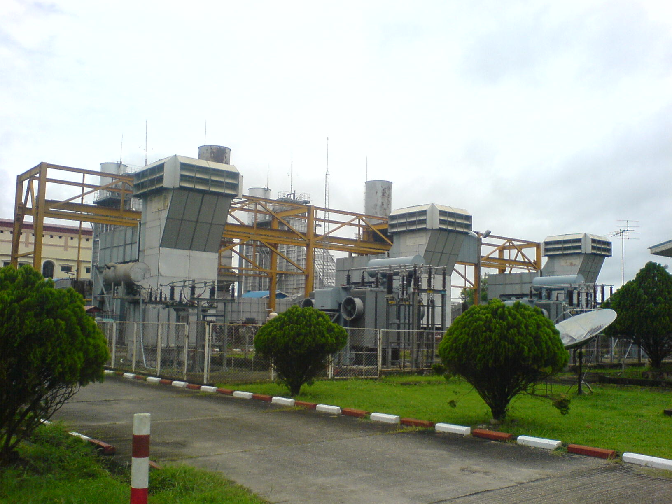

Slide 47
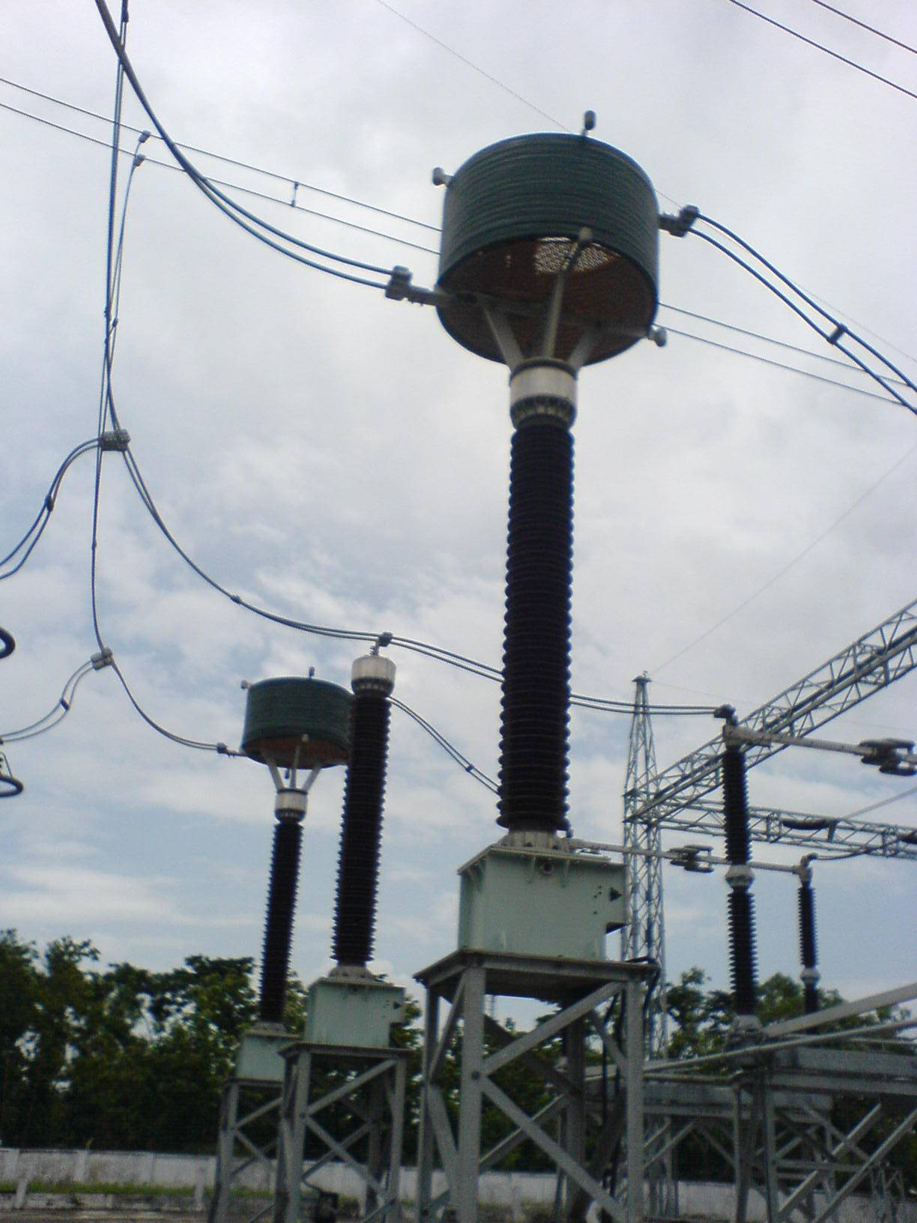

Slide 48
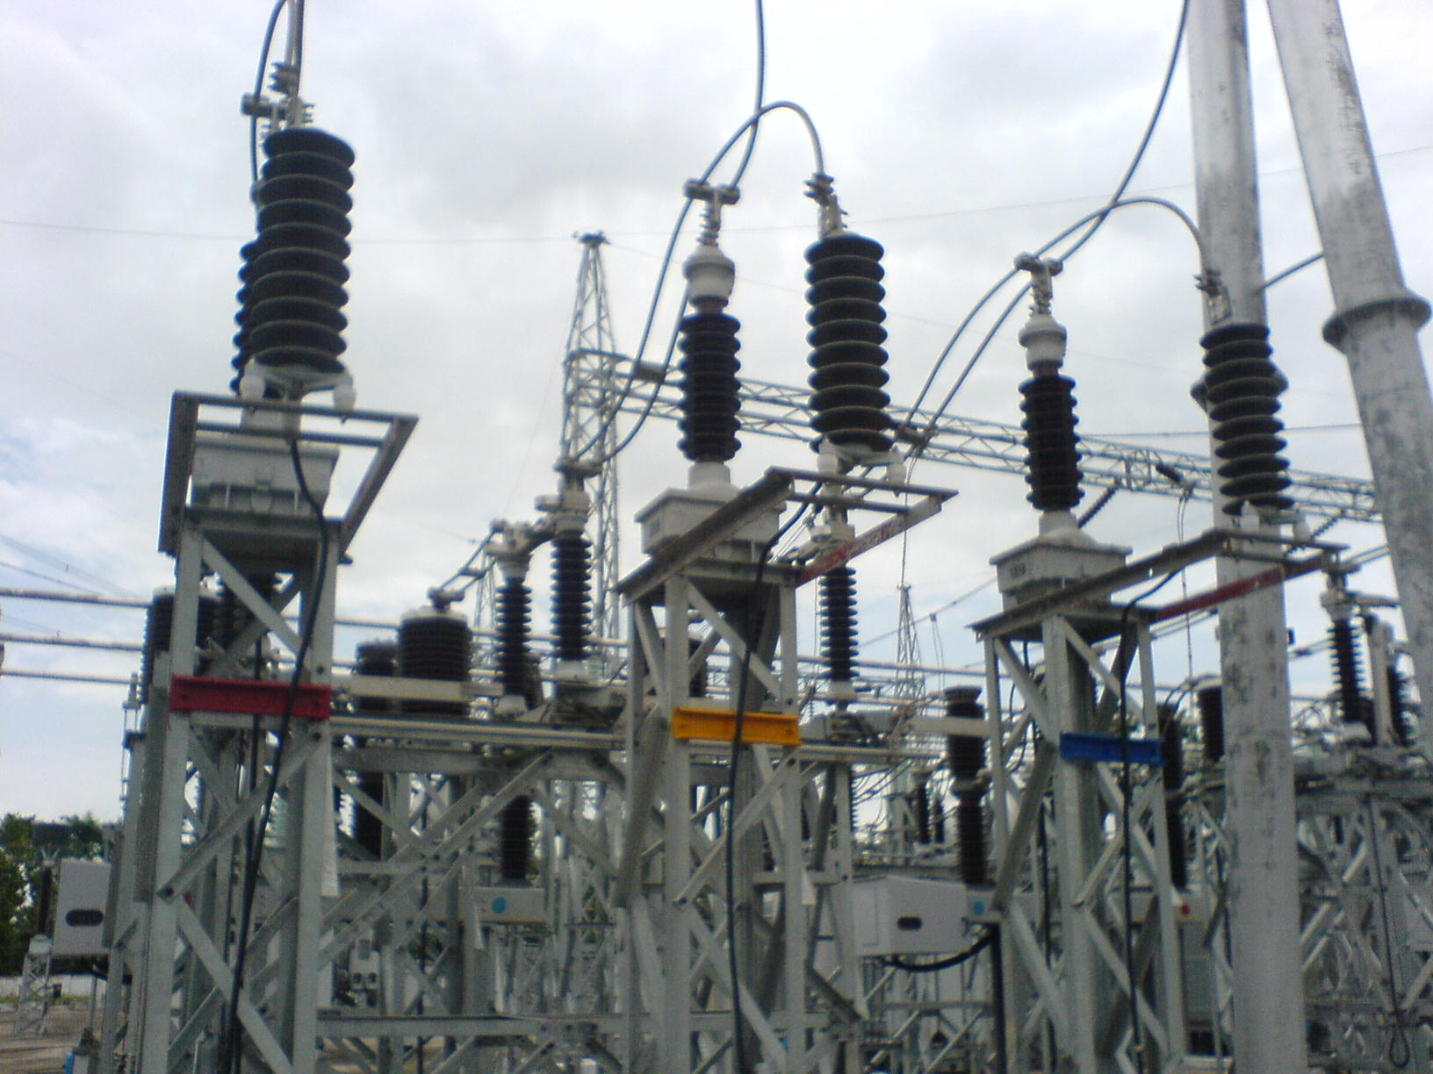

Slide 49
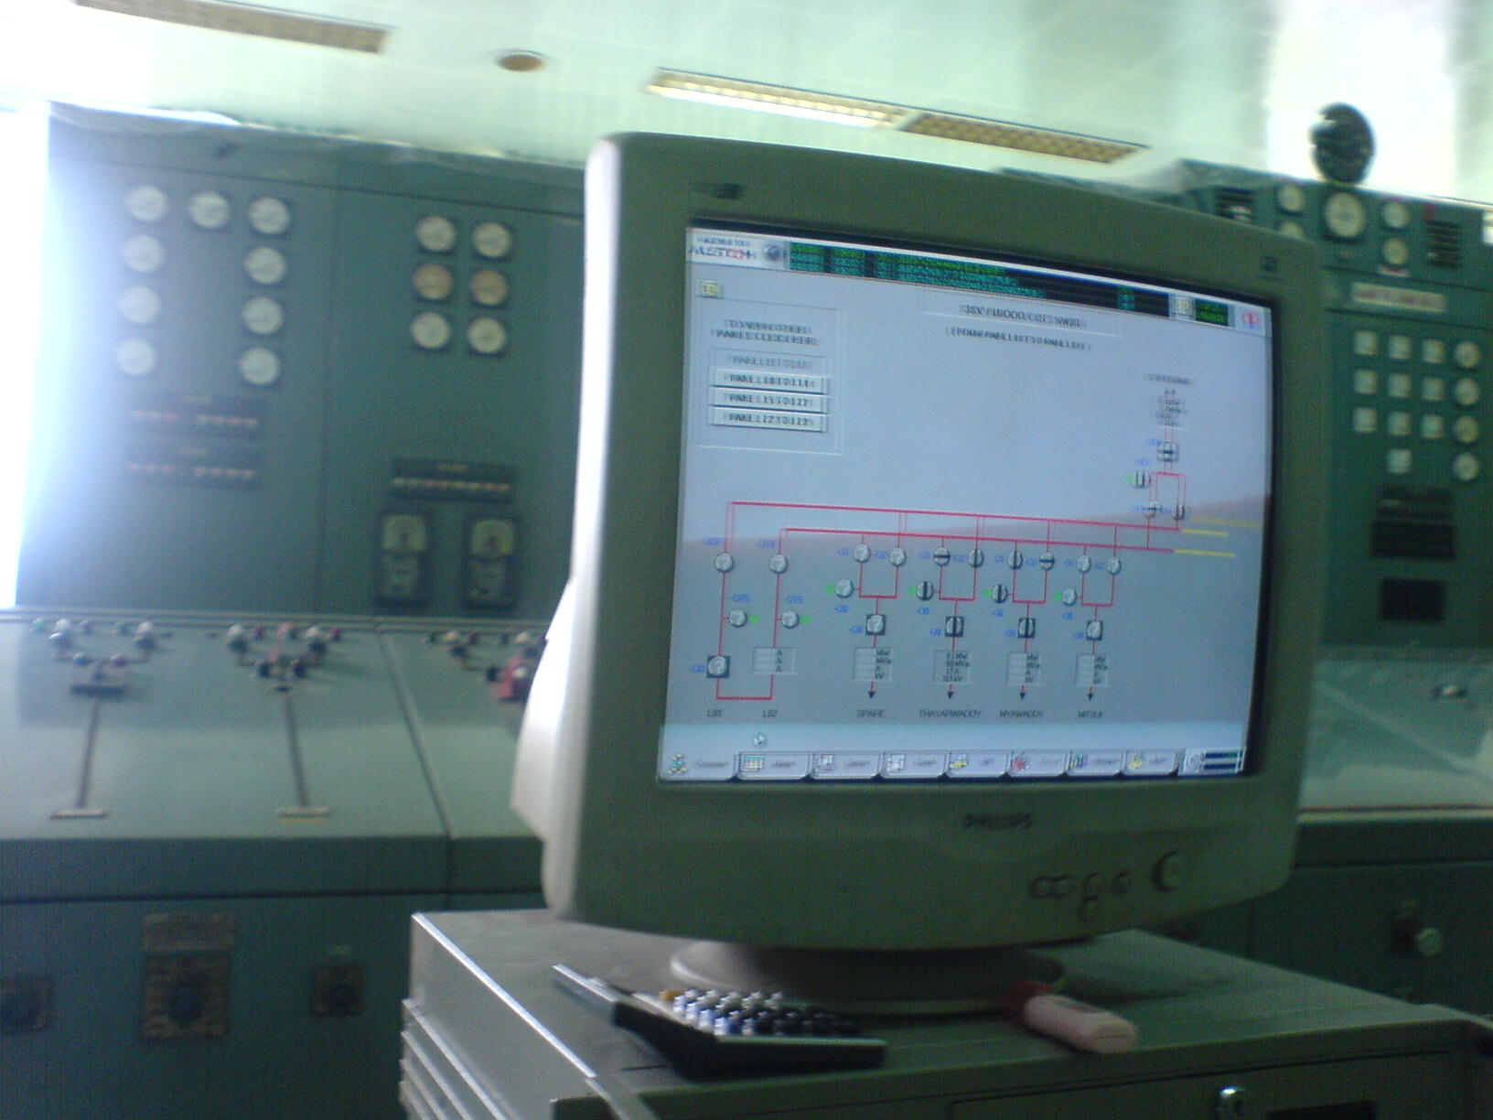

Slide 50
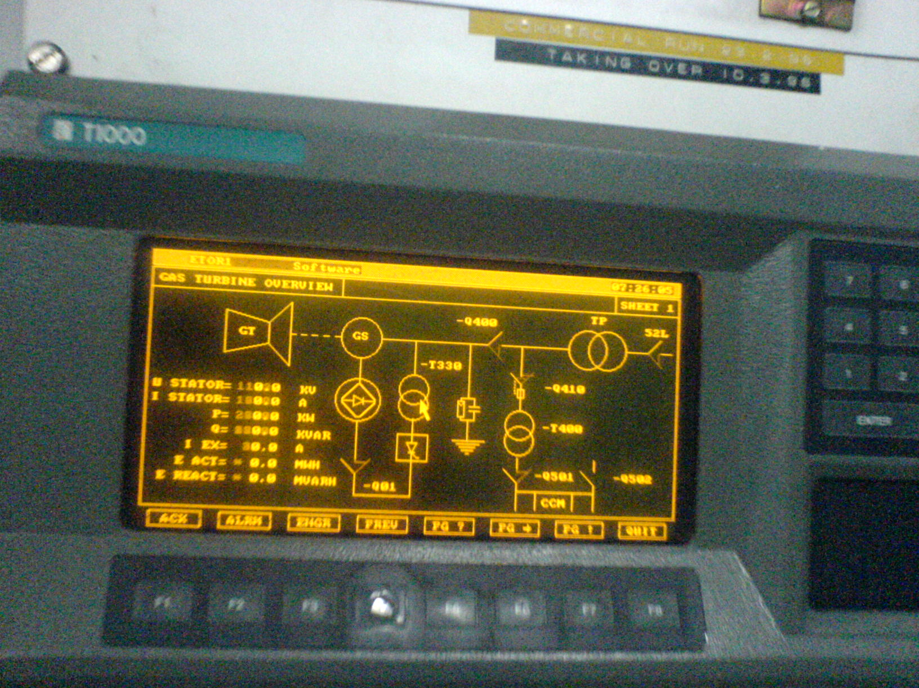

Slide 51
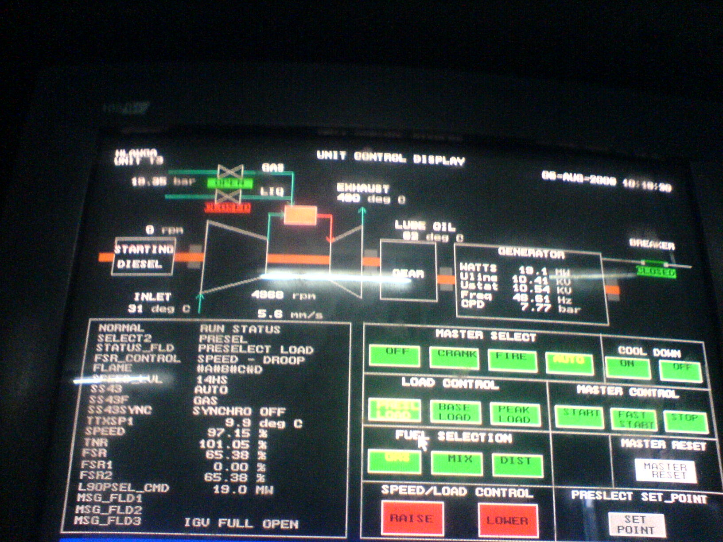

Slide 52
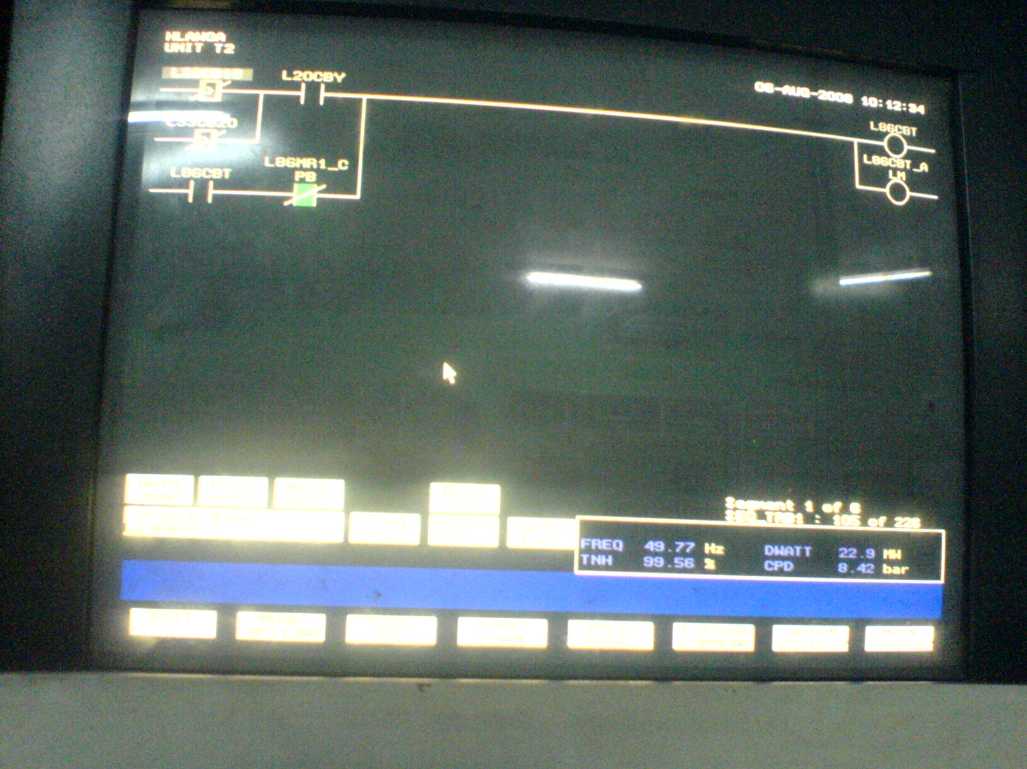
THANK U VERY MUCH

