Slide 1
EE Accreditation Action Plan 2015
First University to Accredit in Myanmar
"Yangon Technological University'
13.1.2015
Prof.Dr.Charlie Than,

Slide 2
Engineering Education
Engineering education is the activity of teaching knowledge and principles related to the professional practice of engineering. It includes the initial education for becoming an engineer and any advanced education and specializations that follow.
http://en.wikipedia.org/wiki/Engineering_education
Engineering education is typically accompanied by additional examinations and supervised training as the requirements for a professional engineering license.

Slide 3
Background of Quality Assurance
“Quality in the sense of achieving academic excellence has always been a central value in higher education” (Schwarz and Westerheijden 2007)
The key strands of the historical, philosophical, political, and social foundations of Quality Assurance in EE.
The first is academic peer-review-based Accreditation,
The second is governmental oversight,
The third includes the Scientific Education and Management Movements,
The fourth is the Accountability movement.

Slide 4
The key strands of the historical, philosophical, political, and social foundations of Quality Assurance in EE.
Peer-review-based Accreditation
Governmental oversight,
Scientific Education and Management Movements,
Accountability

Slide 5
Scientific Management Movement in Higher Education(3)
The Educational Process Cycle modified from IPO framework of educational quality

Slide 6
Quality as a Function of Time and Methods
Total Quality Management (TQM)
Quality Through
Design
Quality
Statistical
Process
Control
(SPC)
Improved Design
Inspection
1920
1940
1960
1980
2000

Slide 7
Time Line of Engineering Education
1800Accreditation
1960 Evaluation
1980 Assessment
1994 Learning Outcomes
2002 Accountability

Slide 8
QA=AEAA
Accreditation
Assessment
Accountability
Evaluation

Slide 9
Engineering Accords
1989 Washington Accords
2001 Sydney Accords
2002 Dublin Accords
2007 International Engineering Alliance

Slide 11
Using the Self-Assessment Tools

Slide 13
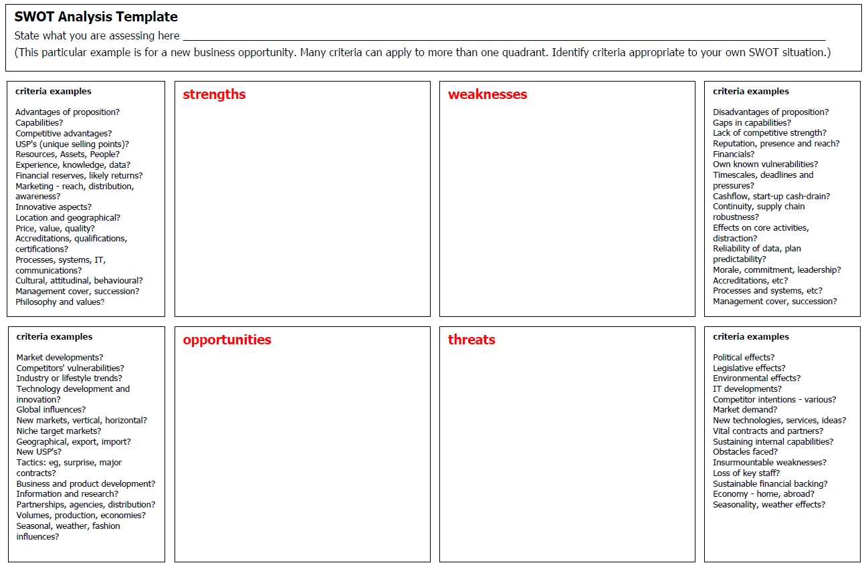

Slide 14
Crosby’s Maturity Grid
1.Uncertainty (adhoc)
2.Awakening (recognition begins but management unwilling to spend on quality)
3.Enlightenment (management begins to support quality improvement program, culture of openness)
4.Wisdom (management fully participates, defect prevention is now part of the culture)
5.Certainty (the whole organization is involved in continuous improvement)

Slide 15
Certainty
Wisdom
Enlightenment
Awakening
Adhoc

Slide 16
How do I become licensed engineer? (USA)
Step 1: Graduation
The first step is graduating from an ABET-accredited engineering program at a college or university.
Step 2: Fundamentals of Engineering (FE) Exam
Step 3: Work Experience
Step 4: Principles and Practice of Engineering
(PE) Exam
http://www.ncees.org/licensure/licensure_for_engineers/

Slide 17
Observation Trip To IEET,Taiwan.

Slide 22
FEIAP 2015 Accreditation Action Plan
Institutional Training on Self -Assessment Report Preparation. 24.1.2015 YTU.
Evaluators' Training.
Workshop on Capstone Design Course .
Accreditation Visit by IEET to YTU.

Slide 23
Timeline for Accreditation
1 | 2014 December | Accreditation policies and procedures Published
2 | 2015 January | Orientation for Institutional Representatives, Rectors and Pro-Rectors Forums
3. | 14.2.2015 | Deadline for Request for Accreditation
4. | 2015 May | Capstone Course Workshop
5. | 31.7.2015 | Deadline for Self-Study Report.
6. | 2015 August | Program Evaluators workshop
7. | 2015 September | Conveners,Team Chairs meetings
8. | 2015 October | On-Site visit
9. | 2015 November | Editors meetings
10. | 2015 December | Accreditation Decision Meeting.
11. | 2016January | EAC General Assembly, Accreditation certificate conferment ceremony for 2015 Accreditation Cycle.

Slide 24
Accreditation Fee schedule
Fee Type | Fee |  | Charge(K)
General Review | Registration Fee
 | Review Fee | Program Base Fee
 | Accreditation Maintenance Fee(per year) | Accredited
 |  | Provisionally Accredited
Follow up Review | Revisit visit fee(per trip) | Action pending
 |  | Provisionally Accredited
Appeal | Appeal Fee
Notes:1.A program's Review Fee will be based on the number of program. Program Review Fee is capped 16,250,00 Kyats per general review. The maximum fee includes Registration Fee,Review Fee,and Annual Accreditation Maintenance Fee for programs.
2.Annual Accreditation Maintenance Fee shall be pay in full on the valid accredited period once the accreditation action has been announced.

Slide 25
Procedures for Nomination of Accreditation Team Members, EAC
Program evaluator must attend Program Evaluator Training Work shop. One of the following qualifications applies
Academia: Senior Professor
Industry
At least ten years of practical experience in the industry
With experience in administration and management.
Non-profit research and development institutes: senior engineer.

Slide 26
Procedures for Nomination of Accreditation Team Members,EAC
Accreditation team convener and chair
Having observed an on-site visit, or been a discipline coordinator for a domestic evaluation project.
Having held department chair or above position at a university and participate the accreditation affairs actively.

Slide 27
Myanmar Engineering Council
ENGINEERING EDUCATION
ACCREDITATION MANUAL
by
Engineering Accreditation Committee(EAC)
24.8.2014

Slide 28
Engineering Education Accreditation Manual
Final draft of the accreditation manual.
Prepared by members of engineering accreditation committee. MEngC.
Outlines details for accreditation of an engineering program.
To ensure a Continual Quality Improvement(CQI) culture .

Slide 29
1.0 Introduction
Increasing need and demand of Engineering Education accreditation for mobility.
Engineering Accreditation Committee was set up by M.Eng.C to be the body for accreditation of engineering education.
Serves to facilitate Technological Institutions/
Universities to meet the minimum standard stipulated for accreditation.

Slide 30
2.0 Composition & Terms of Reference
EAC is composed of M.Eng.C members
To implement accreditation policy
To formulate guidelines and procedures
To appoint an Evaluation team
To receive and review evaluation reports
To respond to M.Eng.C on complaints and appeals
To represent M.Eng.C in mutual recognition agreements
To report periodically to the M.Eng.C on its work

Slide 31
3.0 Accreditation Objective
To ensure the graduates of the accredited programs satisfy the minimum requirements.
To provide feedback to the Technological Universities/ Institutions for the improvement and development
To ensure that Continual Quality Improvement is being practiced by Technological Institutions

Slide 32
4.0 Programme Objectives
Program Objectives(PEO): the programme shall have published Programme Objectives.
Processes and Results: the programme shall have a clear linkage between Programme Objectives and Learning Outcomes.
Stakeholders Involvement: the technological institutions shall provide evidence of stakeholder involvement.

Slide 33
6.0 Accreditation Policy
6.0 Accreditation PolicyAccreditation will be considered upon a written request from an Technology Institution
6.1 Accreditation ProcessThe EAC’s accreditation process will focus on outcomes and the internal systems to ensure that the graduates are adequately prepared for engineering professional.
6.2 The Accreditation CycleAccreditation is accorded to a programme for a maximum period of five years. Technological Institutions shall apply for re-accreditation not less than six months before the expiry of the accreditation period.

Slide 34
6.3 ProgrammesFull-time, part-time, distance learning, joint degree, multi campus etc. For each of the programmes, the Technological Universities/Institutions shall apply for accreditation separately.
6.4 Application and Preparation for Accreditation VisitApplication should be made for programme accreditation as per requirements. Further information shall be required to provide if the submitted documents are found to be inadequate.
6.5 Accreditation EvaluationIs conducted to verify that the programme under evaluation is in compliance with the appropriate accreditation criteria. Done by an Evaluation Panel appointed by EAC.

Slide 35
6.6 Accreditation Decision
1)To accord accreditation for five years
2)To accord accreditation for less than five years
3)Provisionally Accredited for new programs
4)To decline accreditation, a further application will normally not be considered in such a case.
6.7 Revisions to an Accredited Programme
The Technological Institutions shall advise the EAC of any changes made to an accredited programme. Failure to do so may cause the EAC to withdraw the accreditation.
6.8 The Approval to Conduct a Programme
The Technological Institutions intending to conduct a new programme shall obtain approval from the relevant authorities.

Slide 36
6.9 Publication of Accreditation Status
EAC shall regularly update the list of accredited programmes.
6.10 Appeal Procedures
Only not-to-accredit actions may be appealed and a notice of appeal must be submitted within 30 days of receiving notification of the not-to-accredit decision to the Accreditation Appeals Board consisting of M.Eng.C President, EAC Chair and Rectors of Technological Institutions.
6.11 Confidentiality
Documents or other information obtained by the Evaluation Panel, EAC members and EAC staff in connection with the accreditation exercise shall be treated as confidential.

Slide 37
6.12 Expenses
The Technological Institutions shall bear all costs incurred in carrying out activities related to the approval and accreditation of a programme.
6.13 Conflict of Interest
Members of the EAC, Evaluation panels, Appeals Board and EAC staffs shall declare their interest or withdraw from any situation or activity that may constitute a conflict of interest.
The intent of this policy is to:
1) Maintain credibility in the accreditation process and confidence in the decisions of the Central Executive Committee, committee members, committee team chairs, program evaluators , consultants and staff members;
2) Assure fairness and impartiality in decision-making; and
3) Avoid the appearance of impropriety.

Slide 38
7.0 Accreditation Procedure
This section describes EAC’s accreditation procedures from the process of application to the notification of accreditation results.
7.1 Application for Accreditation
For a new programme, the Technological Universities/Instituions should apply for accreditation at least 6 months before the final examination of the first intake of students.
For a current accredited programme, the Technological Universities/Institutions should apply for re-accreditation at least 6 months before the expiry of date of the accreditation.

Slide 39
7.2 Appointment of Evaluation Panel
On submission of all required documents, an Evaluation Panel shall be appointed. Members of the Evaluation Panel are selected on the basis of their expertise and standing in a particular discipline of engineering.
7.3 Scheduling of a Visit
A visit is arranged and coordinated by the EAC on an appropriate date suitable to both the Evaluation Panel and the Technological Universities/Institutions.
7.4 Pre-Accreditation Visit Meeting
The Evaluation Panel should meet at least once before the actual accreditation visit takes place, in order to study and discuss documents, and systematically identify shortcomings.

Slide 40
7.5 Accreditation Visit
The accreditation visit will normally be scheduled for a period of two days. The overall conduct of the visit shall be managed by the EAC. Meetings with all stakeholders are important as this would give an indication of their involvement in the CQI process of the programme.
7.6 Report and Recommendation
The report from the Evaluation Panel shall be submitted to the EAC within 4 weeks after the visit.

Slide 41
8.0 Qualifying Requirements and Accreditation Criteria
The assessment process will involve two parts:
Initial Assessment of qualifying requirements
Detailed Assessment of the programme based on the accreditation criteria
Criterion 1 Academic Curriculum
Criterion 2 Students
Criterion 3 Academic and Support Staff
Criterion 4 Facilities
Criterion 5 Quality Management Systems

Slide 42
8.1Criterion 1: Academic Curriculum
The academic curriculum and curricular design shall be strongly reflect the philosophy and approach adopted in the programme structure, and the choice of the teaching-learning (delivery) and assessment methods.
A balanced curriculum shall include all technical and non-technical attributes listed in the Learning Outcomes, and there shall be a balance between the essential elements forming the core of the programme and additional specialist or optional studies (electives).

Slide 43
For industrial training, the following guideline shall be followed:
Industrial training shall be for a minimum of 8 weeks of continuous training. One credit hour is allocated for every two weeks of training subject to a maximum of six credit hours.
The training shall be adequately structured, supervised and recorded in log books/report. The industrial training must be conducted before the final semester.

Slide 44
For a final year project, the following guideline shall be followed:
A final year project is subject to a minimum of six credit hours and a maximum of twelve credit hours.
Technological Institutions may use their version of the credit hours; however they must provide the equivalency according to the EAC’s definition of credit hours.

Slide 45
8.2 Criterion 2: Students
The quality and performance of students, in relation to the Learning Outcomes is of utmost importance in the evaluation of an engineering programme.
The programme shall provide the necessary teaching-learning environment to support the achievement of the Programme Objectives and Learning Outcomes.
The teaching-learning environment shall be conducive to ensure that students are always enthusiastic and motivated.
The Technological Universities/Institutions shall provide necessary counselling services to students regarding academic, career, financial, and health matters.

Slide 46
8.3 Criterion 3: Academic and Support staff
A viable engineering programme is expected to have a minimum of 8 full-time academic staff relevant to the particular engineering discipline.
Technological Institutions may engage part-time staff with acceptable professional qualifications in the related engineering fields. The full-time equivalent of part-time staff shall not exceed 40%.
The overall competence of the academic staff may be judged by such factors as education, diversity of background, engineering experience, teaching experience, ability to communicate, enthusiasm for developing more effective programmes, level of scholarship, participation in professional societies and attainment of Professional Engineer status or as Corporate Members of Learned Bodies.

Slide 47
8.4 Criterion 4: Facilities
There must be adequate teaching and learning facilities such as classrooms, learning-support facilities, study areas, information resources (library), laboratories and workshops, and associate equipment to cater for multi-delivery modes.
Technological Institutions must ensure that all facilities are maintained and adhered to best practices in safety, health and environment where appropriate.
Support facilities such as hostels, sport and recreational centres, health centres, student centres, and transport must be adequate to facilitate students’ life on campus and to enhance character building.

Slide 48
8.5 Criterion 5: Quality Management Systems
The Technological Institutions must ensure that there exists a quality management system to oversee and monitor the overall achievement of the programme objectives.
These include the controlling, managing, directing, organising and supervising of the overall management system of the Technological Institutions.
It must have adequate arrangements for planning, development, delivery and review of engineering programmes together with the academic and professional development of its staff.

Slide 49
9.0 Accreditation Documents
9.1 Introduction
9.2 Self-Assessment Report-Hardcopy
9.2.1 General Information
9.2.2 Programme Objectives
9.2.3 Learning Outcomes
9.2.4 Academic Curriculum
9.2.5 Students
9.2.6 Academic and Support Staff
9.2.7 Facilities
9.2.8 Quality Management System
9.2.9 Other Relevant Information

Slide 50
9.3 Supporting Material Document-Digital Format
9.3.1 Supporting Information
9.3.2 Academic and Laboratory Support Staff
9.3.3 Programme Structure and Contents
9.3.4 Equipment, Software and Titles of Books and Journals
9.3.5 External Examiner and Advisory Board

Slide 51
9.4 Institutional Documents and Additional Documentation to be made Available during the Visit
9.4.1 Technological Institution Documents
9.4.2 Documents Related to Programme Objectives and Outcomes
9.4.3 Final Project Reports
9.4.4 Industrial Training Reports
9.4.5 Laboratory Reports
9.4.6 Quality Assurance Records
9.4.7 Other Documentation

Slide 52
9.5 Accreditation Actions
NGR(Next General Review)
IR(Interim Report)
IV(Interim Visit)
SCR(ShowCase Report)
SCV(ShowCase Visit)
RE(Report Extended)
VE(Visit Extended)
SE(ShowCase Extended)
NA(Not to Accredit)

Slide 53
Glossary
In Annex, Glossary of Key Terms for Engineering Education Accreditation is described.
There are (48) Key Terms included in Annex.

Slide 54
MYANMAR ENGINEERING COUNCIL ENGINEERING EDUCATION Self-Assessment Report Guidelines
Table of Contents
Introduction
General Information
Programme Accreditation History
Programme Objectives
Programme Outcomes
Requirements and Preparation
Preparing a Check List for a review
Submission and Distribution of Check List Report
GENERAL CRITERIA
CRITERION 1. ACADEMIC CURRICULUM
CRITERION 2. STUDENTS
CRITERION 3. ACADEMIC AND SUPPORTING STAFF
CRITERION 4. FACILITIES
CRITERION 5. QUALITY MANAGEMENT SYSYTEM
Institutional Documents and Additional Documentation

Slide 55
The Five Stage Quality Assurance Model
M Eng C will used the following approach on Accreditation:
Sets of Accreditation manual and guidelines formulated.
A Self Assessment Report prepared by the institution
The appointment of a peer group(Evaluation Panel) whose review of the institution or programme would start with a review of the self evaluation.
Site visits by the peer group(Evaluation Panel) .
The publication of a report or, in some cases, only the decision .

